Slide 1
Technin 510 Week 4
Machine Learning
10/20/21

Slide 2
Today
Technin510 S3 What is ML – Review (bias/variance, regularization, irreducible error)
Features for Visual Data
Evaluating Performance for Classifiers
Lunch
Technin510 L4 Image Classification

Slide 3
Features for Visual Data
Image Features
Feature extraction is a type of dimensionality reduction
The process of reducing the number of random variables under consideration
The purpose of this is to reduce the input data to only the most salient information (meaningful features that can be used for prediction)

Slide 4
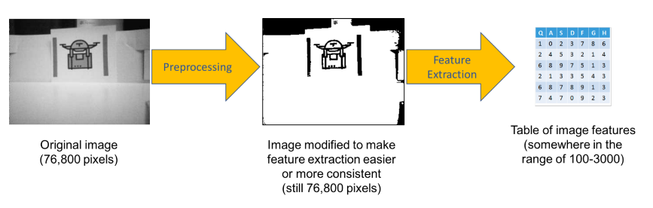
For Example…
A | B | C | D
9 | 8 | 9 | 0
1 | 3 | 7 | 9
9 | 6 | 7 | 3
Original image
Preprocessing (noise removal, resizing, grayscale/bw, etc.)
Table or array of features

Slide 5
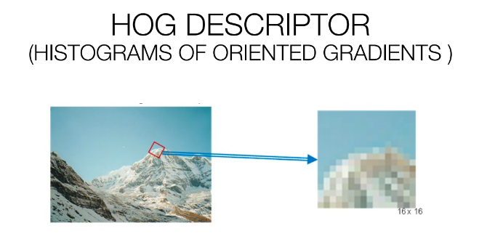
Histogram of ordered gradient (HOG) Descriptor
A nice explanatory link

Slide 6
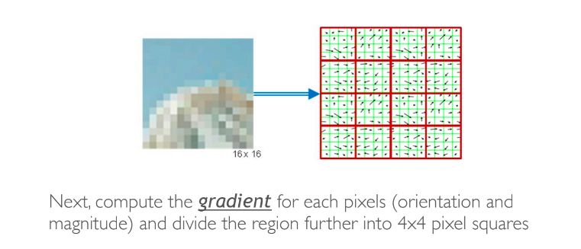
HOG Descriptor

Slide 7
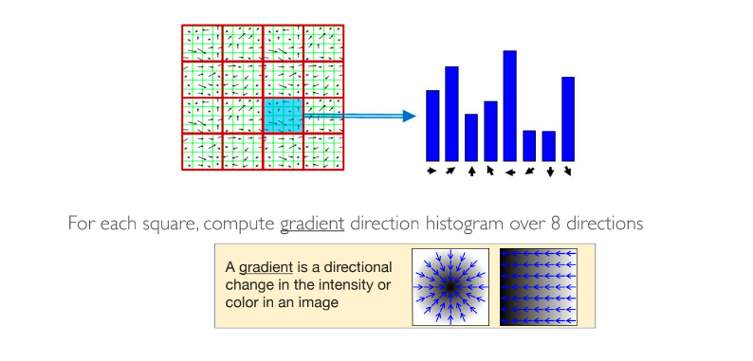
HOG Descriptor

Slide 8
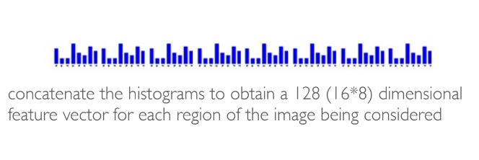
HOG Descriptor

Slide 9
HOG Descriptor
For small-scale recognition tasks
Until deep learning approaches HOG-based approaches were leading edge

Slide 10
Classification Models
Confusion Matrix
Accuracy
Precision and Recall
F measure
Evaluating Performance for Classifiers

Slide 11
Confusion Matrix
Serves as the basis for analyzing what’s going wrong, as well as for calculating other performance measures
 | (+) | (-)
(+) | True Positives (TP) | False Negatives (FN)
(-) | False Positive (FP) | True Negative (TN)

Slide 12
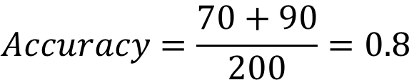
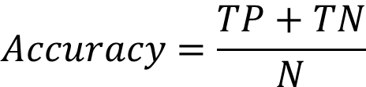
Accuracy
Accuracy is the percentage of correctly classified instances
$$Accuracy=\frac{TP+TN}{N}$$
 | (+) | (-)
(+) | TP = 70 | FN = 30
(-) | FP = 10 | TN = 90
$$Accuracy=\frac{70+90}{200}=0.8$$

Slide 13
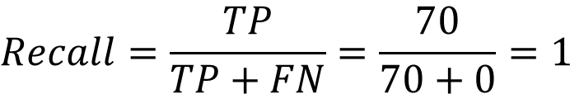
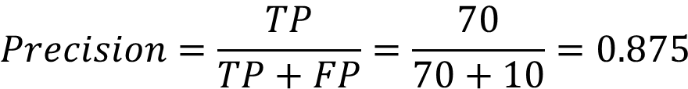
Precision and Recall
 | (+) | (-)
(+) | TP = 70 | FN = 0
(-) | FP = 10 | TN = 0
Precision: the fraction of samples classified as belonging to class X truly belong to that class
Recall: of the total number of samples that truly belong to class X, how many does this model classify correctly?
When the sample is actually yes, how often does the classifier predict yes?
$$Precision=\frac{TP}{TP+FP}=\frac{70}{70+10}=0.875$$
 | (+) | (-)
(+) | TP = 70 | FN = 0
(-) | FP = 10 | TN = 0
$$Recall=\frac{TP}{TP+FN}=\frac{70}{70+0}=1$$

Slide 14
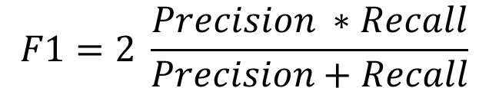
F1: a mix of both
Combines precision and recall (equally) and allows for more accurate evaluation that considers both FP and FN
$$F1=2 \frac{Precision ∗Recall}{Precision+Recall}$$

Slide 15
Key Takeaways
If you have a balanced dataset, accuracy and F1 score are going to give your roughly the same result
For unbalanced datasets consult F1
Diagnose with the confusion matrix

